Slide 1
CC Lab
Week 2: JS Libraries

Slide 2
PComp Shopping WOOHOO!
For week four of CC Lab, please have:
The starter kit from Adafruit: https://www.adafruit.com/products/170
OR
The starter kit from 16Hertz: https://www.amazon.com/gp/offer-listing/B00OHQ3BFE
(If you’re taking PComp classes, you’ll probably already have these things.)
Alternatively, you can also send an email out on listserv and see if any of the previous students have any similar Arduinos and parts that they’re willing to sell for a cheaper price.

Slide 3
What are JavaScript libraries?
A JavaScript library are file(s) with pre-written JavaScript in them and makes it easier to develop JavaScript-based applications.

Slide 4
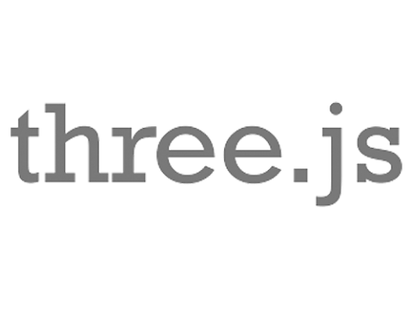



Some Common JavaScript Libraries
jQuery
DOM manipulation
d3.js
Data visualizations
p5.js
Processing for web
three.js
3D/webGL
Notes:
Show your students some live examples for pizzazz!

Slide 5
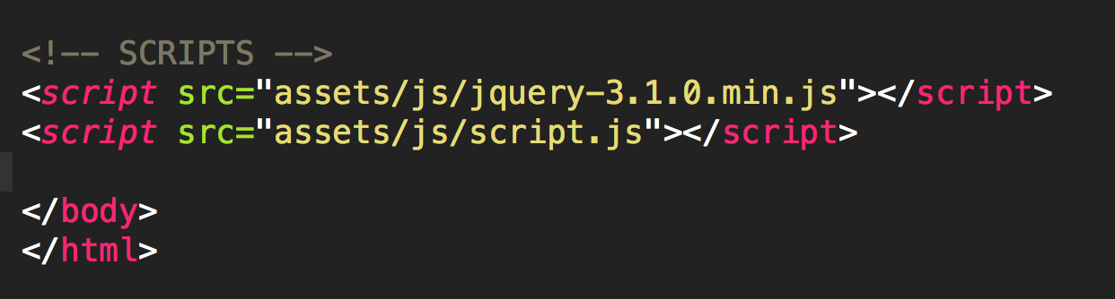
How to use libraries?
Download, copy to your folder, then link them to your html file, just like any other external JS file.

Slide 6
Alternatively, there are sites such as Google, Yandex, jQuery,etc. who host popular JS libraries for you to link to.
Benefits
CDN-hosted, which likely means faster than the hosting provider your site is with.
Less content for your web server to serve to your clients.
Instantly-updated libraries, if you link to the “latest” version.
Potentially cached library
Downsides
Potential security issues
If host site is down or inaccessible (i.e. firewall), your site may potentially break

Slide 7
jQuery
Probably the most popular and common JavaScript library in existence.
$
Notes:
jQuery is infamous for its $$$$$ signs.

Slide 8
“Write less, do more.” - jQuery
Javascript var div1 = document.getElementById(“div1”);
jQuery var div1 = $(‘#div’);

Slide 9
To vanilla JavaScript or to jQuery?
That is the question.
(psst… here’s a little joke: http://vanilla-js.com/)
Notes:
If you’re creating large, complex web systems, jQuery is a good way to help you accomplish more by writing less.
However, if you’re just creating a small simple project that only needs a few lines of JavaScript to accomplish, it’s best to stick with JS because it’s less code to load on the whole and thus, faster loading times.

Slide 10
Time to get your hands dirty!
Notes:
Have your students download and link both jquery library and script.js.

Slide 11
Homework
Use jQuery and one other library to create something awesome.
Notes:
jQuery is infamous for its $$$$$ signs.

Slide 12

Album of the week
Joe Ford – Let it out
https://shogunaudiojoeford.bandcamp.com/album/let-it-out-ep
Notes:
jQuery is infamous for its $$$$$ signs.

